Slide 1
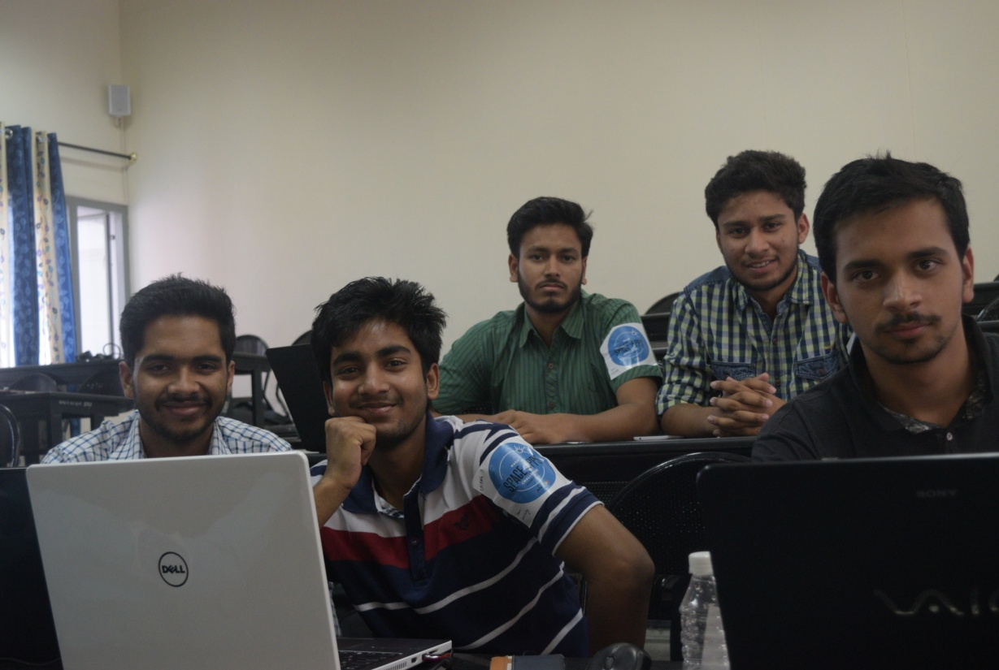
TEAM curiOsity

Slide 2
MEMBERS
Vaibhav Dwivedi
Chirag Singla
Abhishek Agnihotri
Shubham Sirmour
Manan Saroha

Slide 3
ASTROCIZE
The challenge asked us to formulate a workout routine for the astronauts in space. We have chosen this topic because we thought of our astronauts like a soldier out there away from his family collecting datas and suffering through all the pain just to collect info that will be useful in future.

Slide 4
The most common problem experienced by humans in the initial hours of weightlessness is known as space adaptation syndrome or SAS, commonly referred to as space sickness.
The most significant adverse effects of long-term weightlessness are muscle atrophy and deterioration of the skeleton, or spaceflight osteopenia. These effects can be minimized through a regimen of exercise. Other significant effects include fluid redistribution, a slowing of the cardiovascular system, decreased production of red blood cells, balance disorders etc.

Slide 5
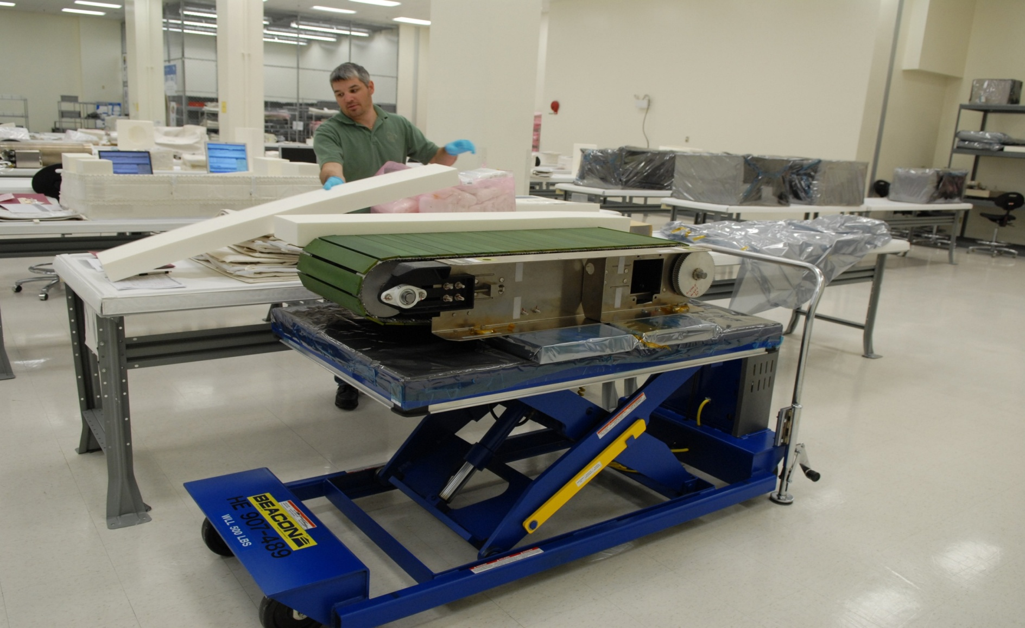
C.O.L.B.E.R.T.

Slide 6
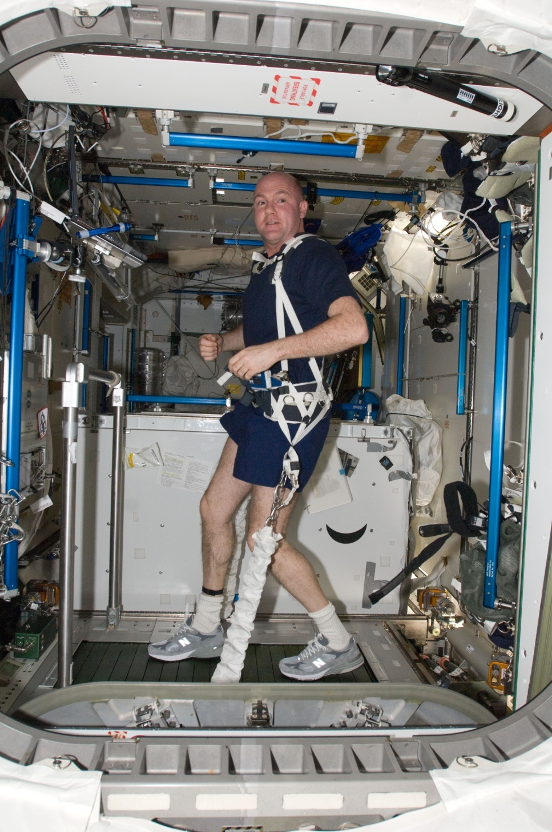
Notes:
Before this another treadmill named TVIS is already there.
The COLBERT features data collection devices that will allow scientists and doctors to evaluate how effective the treadmill exercise is in reducing the amount of bone and muscle density loss due to microgravity exposure.

Slide 7
Recommendations
We can add features like Siri or Cortana to the treadmill to talk with or their families(using the existing technology of Ham Radio) while running on the treadmill to aid the process.This in relation with the Placebo effect. Using a VR kit along with this will help to create a more natural feeling.
Further using tuned mass dampers which have the capability to stabilize 3 times the vibrations against the simple dampers for the same cost and roughly the same weight.

Slide 8
Further we recommend use of the Carbon Fibre against the stainless steel currently used for harnesses and hooks.
Specific tensile strength of various materials
Material | Tensile strength (MPa) | Density (g/cm³) | Specific strength (kN·m/kg or KYuri) | Breaking length (km)
Stainless steel (304) | 505 | 8.00 | 63.1 | 6.4
Carbon fiber (AS4) | 4300 | 1.75 | 2457 | 250

Slide 9
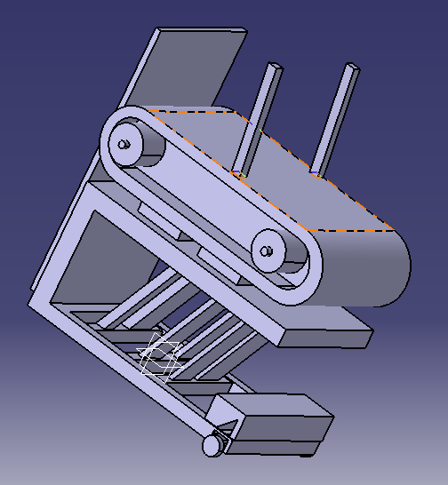
Recommendations Continued…
As can be seen against the same
volume used for both,
carbon fibre provides 40 times
the strength and 80%reduction
in weight which easily compensates
the extra cost of carbon fibre by
reduction in fuel consumption due
to 80% reduction in weight.

Slide 10
ARED
As the ISS orbits the Earth, both the vehicle and crew members are in a constant state of free-fall causing astronauts to experience a feeling of weightlessness.
deterioration and bone density loss, astronauts are prescribed exercise routines by exercise and rehabilitation specialists and medical doctors.
Astronauts are scheduled to exercise approximately two hours per day to maintain their health while on the ISS.

Slide 11
Numerous types of exercise equipment have been used in reduced gravity to evaluate and maintain astronaut fitness. The Advanced Resistive Exercise Device (ARED) allows the crew to engage in resistive exercise onboard the ISS by simulating the use of free weights.
This device is used to maintain muscle strength, bone strength, and endurance. The resistive force is generated by two piston/cylinder assemblies with an adjustable load.

Slide 12
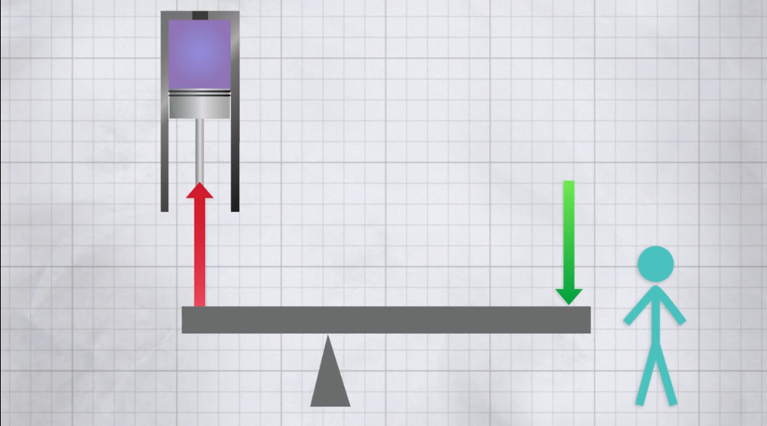

Slide 13
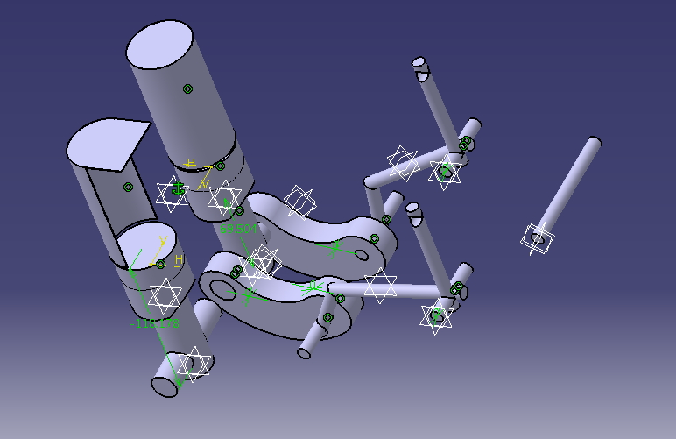
This is a 3D prototype of the basic functioning of the ARED machine.

Slide 14
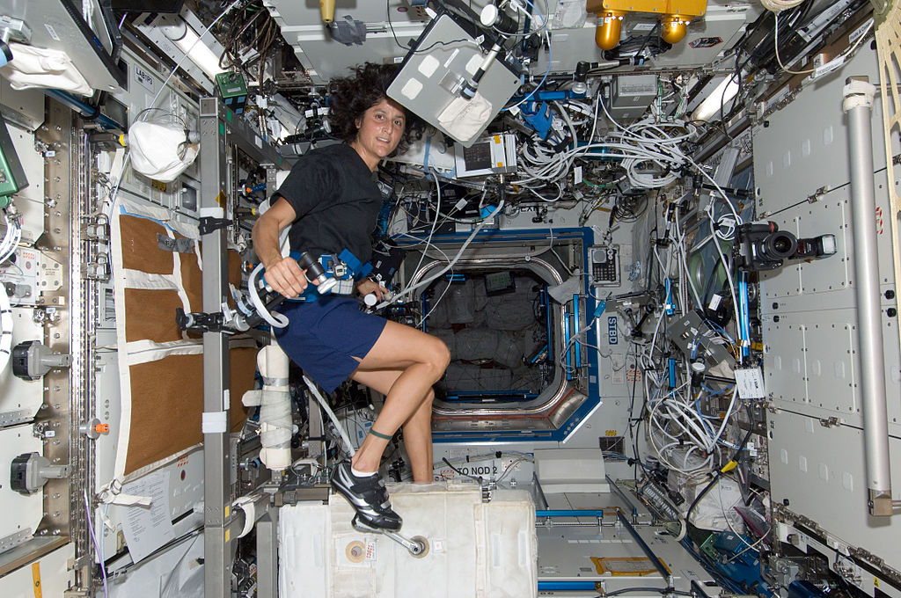
CEVIS Cycle Ergometer with vibration isolation and stabilization

Slide 15
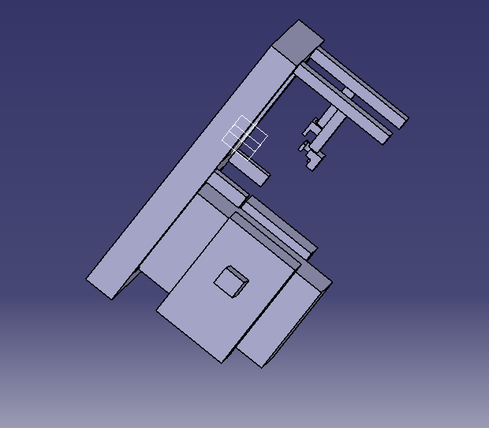
This is a 3d prototype that we have designed on CATIA for the proposed model of the CEVIS machine.

Slide 16
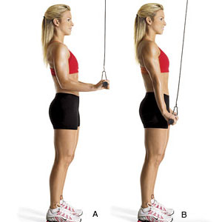
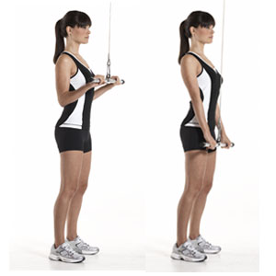
Pull down Exercises
Cycling with these exercises in space could help improve physical stamina
This will really help us for physically demanding space-walk activities outside the space station

Slide 17
COMPUTER PROGRAM TO CALCULATE CALORIES BURNT
We have coded a program in C language to calculate the amount of calories burnt according to the workout you provide incorporating as many as 12 variables!
Further provided your weight we can also provide the best routine that has to be followed to stay fit on board.

Slide 18
ROTATING WHEEL SPACE STATION
NASA has never attempted to build a rotating wheel space station, for several reasons. These are because such a station would be very difficult to construct, given the limited lifting capability available to the United States and other spacefaring nations.
Assembling such a station and pressurizing it would present formidable obstacles, which, though not beyond NASA's technical capability, would be beyond available budgets.

Slide 19
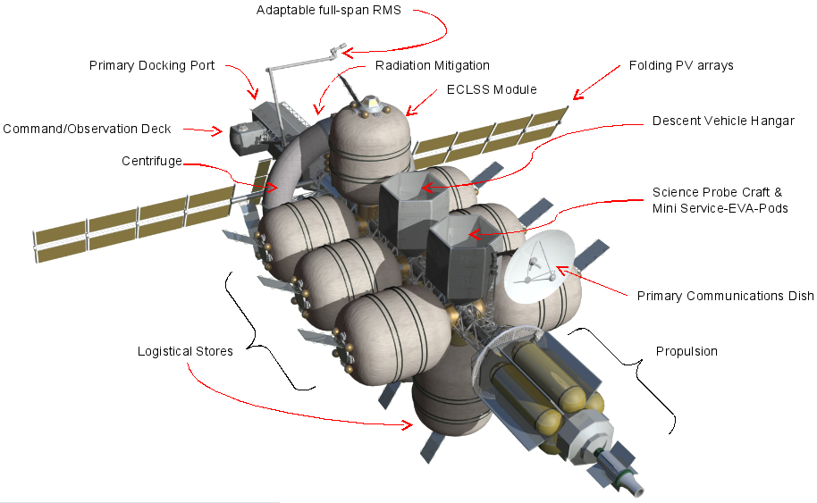

Slide 20
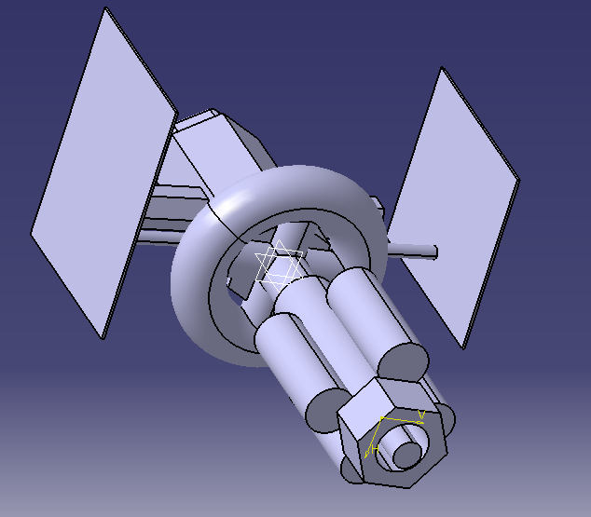
This is what the proposed Rotating space wheel look like as developed in CATIA.

Slide 21
This concept has been formulated for long duration(1 to 24 months) exo-atmospheric space journeys for a six-person crew. In order to limit the effects of microgravity on human health, the spacecraft would be equipped with a centrifuge.
The design is intended to be relatively inexpensive by manned spaceflight standards as it is projected to only cost US$3.7 billion. In addition, it is suggested that it might only need 64 months(margin of error-5 months) of work.
The design is modular, enabling it to accommodate any number of mission specific propulsion modules, manipulator arms, docking port for an Orion or commercial crew capsule, and landing craft for destination worlds.

Slide 22
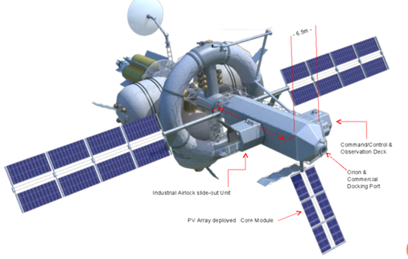

Slide 23
The height taken = 3m The distance from centre = 4m So, The radius = 3+4 = 7m Now, According to the formula a = (V^2)/R where accn = acceleration due to centrifugal force, V= Velocity of rotation, R= radius of centrifuge putting the values (a=g=9.8m/s^-2,R= 7m) we calculate the value of ‘v’ to be = 26.19 m/s

Slide 24
OBJECTIVES ACHIEVED
It would serve in case of emergency station and hospital for current mission crews.^{[1][3]}
Other objectives included:
Self-sustained for long-duration missions with crews as large as 6
Support manned landing missions
Satisfy requirements of NASA Authorization Act of 2010

Slide 25
ATTRIBUTES
Robust Environmental Control and Life Support and communication suite
Large storage volumes (for food, mechanical parts or medical supplies)
Real-time visual command & observe capability for crew
Low crew irradiation
Semi-autonomous integration of multiple mission specific propulsion units.

Slide 26
NASA currently uses transdermal dimenhydrinate patches for tackling SAS.
But studies shows that it impaired decision making reaction time and auditory digit span.
So as an alternative we propose that it should be replaced with Cinnarizine.
It does not contain any major side effects except dry mouth
It is economical and a best alternative to the patches that NASA is currently using.

Slide 27
CONCLUSION
COLBERT’s dampers and hooks were improvised and added a virtual kit to it.
We have improvised CEVIS by using the principal of vaccuum that has been used in ‘THE BEAST’ ARED.
Also we have tried to create a earth like atmosphere, gravity and environment in space by our rotating space module and providing an alternative for the patches being used.
We have formulated programme that will provide a workout routine for astronauts as per their weight, time of pedalling,running etc.

Slide 28
THANK YOU
So thanks everyone for being patient listeners.
We have put a lot of effort in finding side effects and limitations in NASA’s equipments and recommending the best
We hope this will ignite a spark aur will fire up new idea aur tools.

